Slide 1
Lyft Earnings Commitment Verification
Add a brief explanation of the presentation’s purpose

Slide 2
Table of Contents
1 | Data Collection insight on Lyft’s earning commitment and the data collection process.
2 | Data Cleaning Cleaning and normalization for data analysis
3 | Commitment Verification calculating the validity behind Lyft’s Earning Commitment
4 | Visualizations Python visualizations
5 | Conclusion Final interpretation

Slide 3
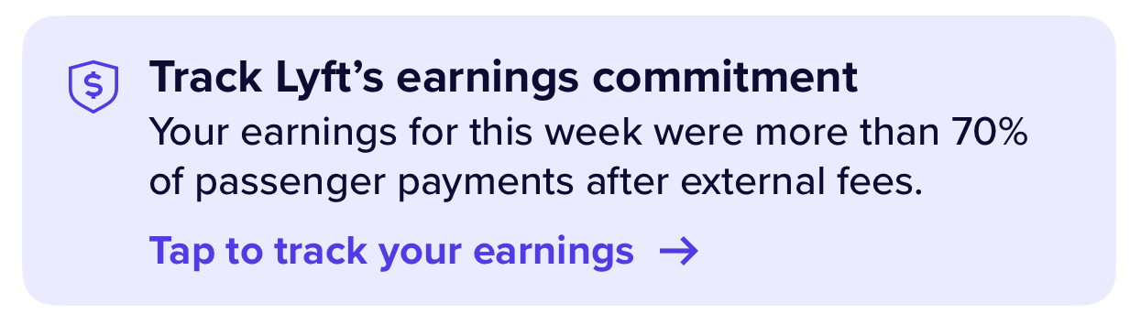
Lyft’s Earnings Commitment
“On a weekly basis, drivers will earn 70% or more of passenger payments after external fees are deducted.”
“Note: Drivers will always receive 100% of tips, adjustments, benefits, and tolls, as they aren't subject to external fees or Lyft's fee.”
https://help.lyft.com/hc/en-us/all/articles/9785135090-earnings-commitment

Slide 4
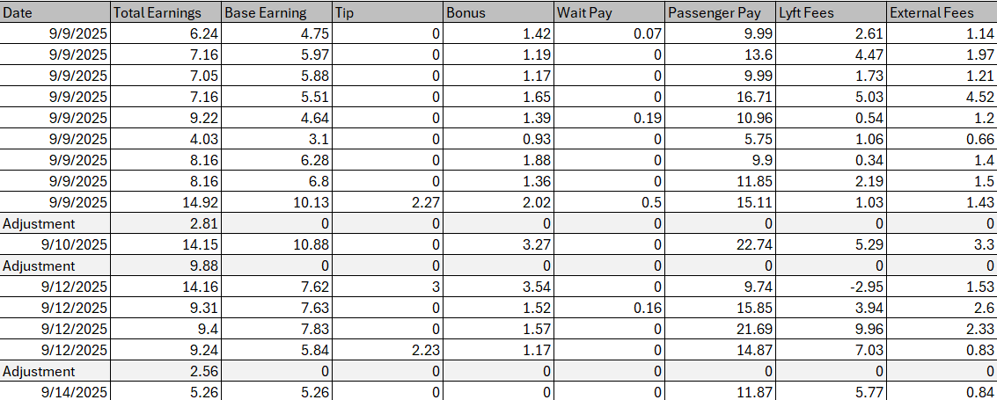
Data Collection
I created a basic Excel CSV file containing the payment and fee information from the week (9/8/2025 – 9/15/2025)

Slide 5
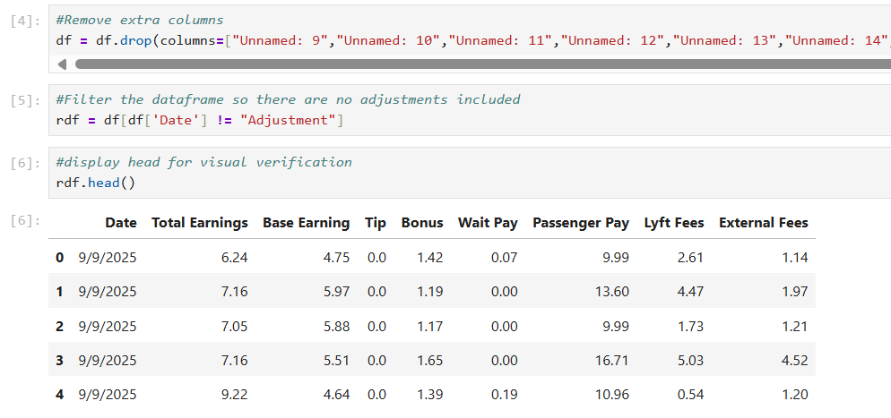
Data Cleaning
I removed extra columns that were displaying empty values in my DataFrame
I separated the rides from the adjustments and saved them as separate DataFrame called “rdf” (Ride DataFrame).

Slide 6
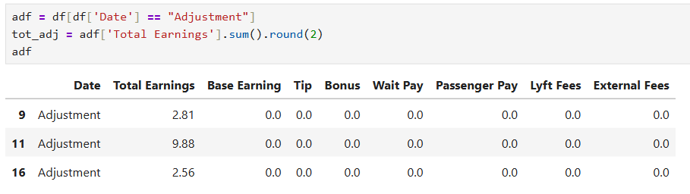
Data Cleaning
I also saved the adjustments as their own DataFrame called “adf” (Adjustment DataFrame).
I used this DataFrame to find the total I was paid in adjustments (tot_adj)

Slide 7
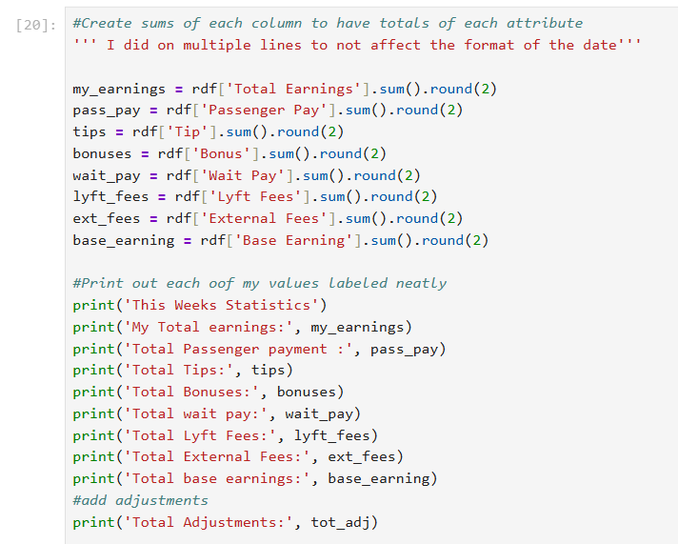
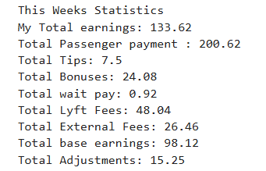
Calculations
I calculated the totals of each attribute and rounded to the hundredths to show monetary value.

Slide 8
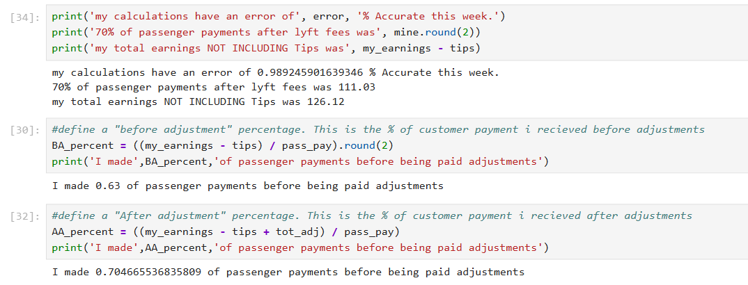
Calculations cont.
I saved those values as their own objects so I could easily use them for further calculations and visualization

Slide 9
Conclusion
Before adjustments (and not including tips), I did NOT make 70% of the passenger payments. I received only 63% of what the customer was paid
After I received my adjustment from Lyft (still not including tips), I earned a total of 70.4% of the customers payment.
This confirms that Lyft paid me an acceptable amount in accordance with the “Earning Commitment Guarantee”

Slide 10
Visualizations

Slide 11
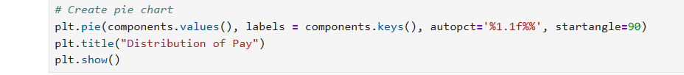
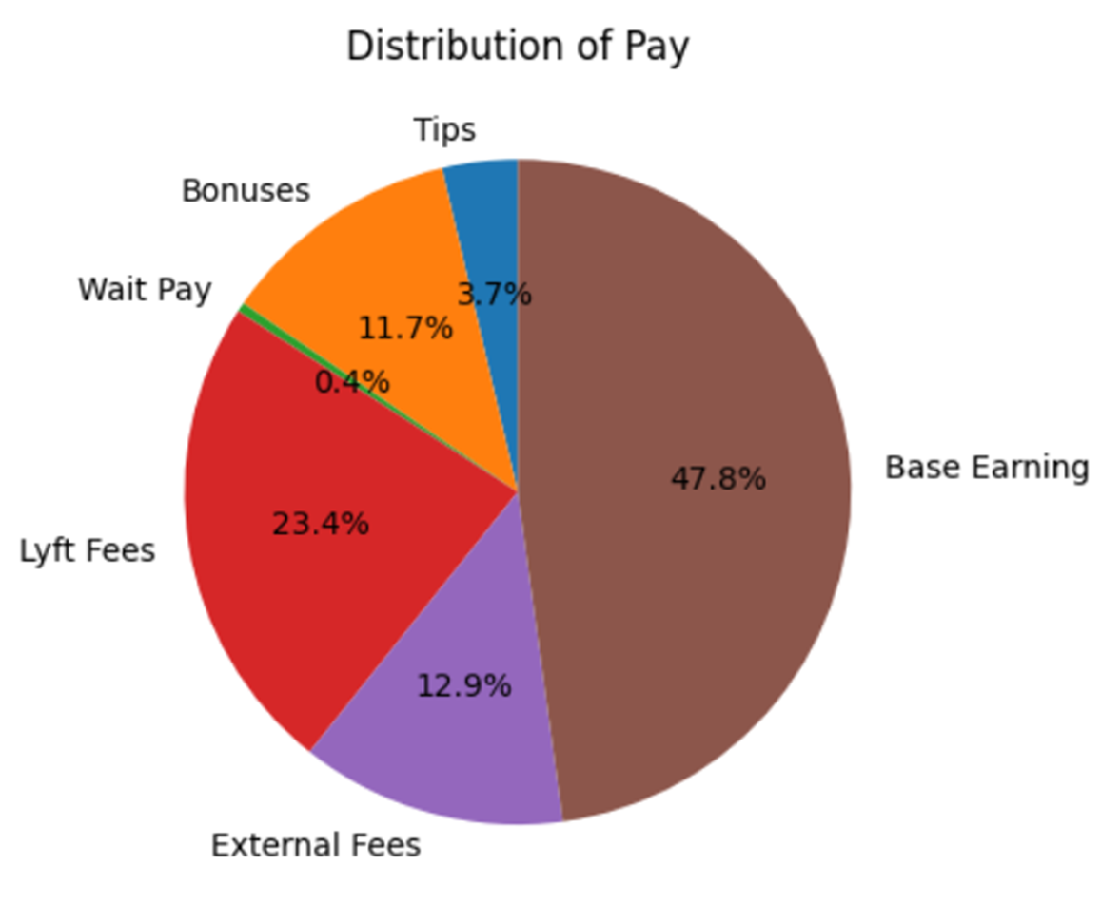
Pie Chart

Slide 12
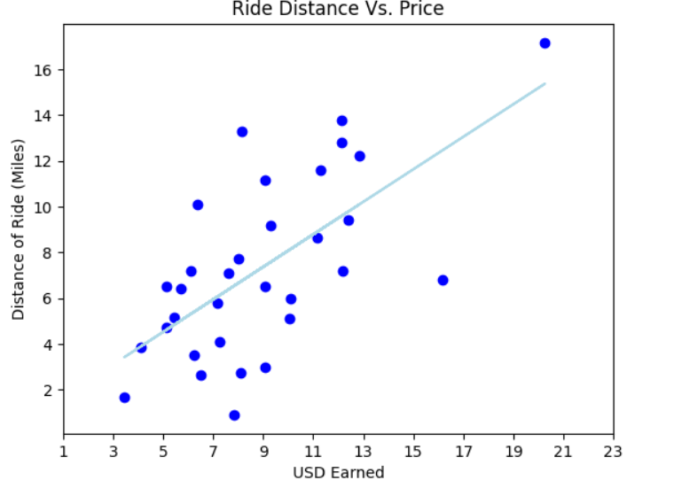
Scatter Plot and Linear Regression

Slide 13
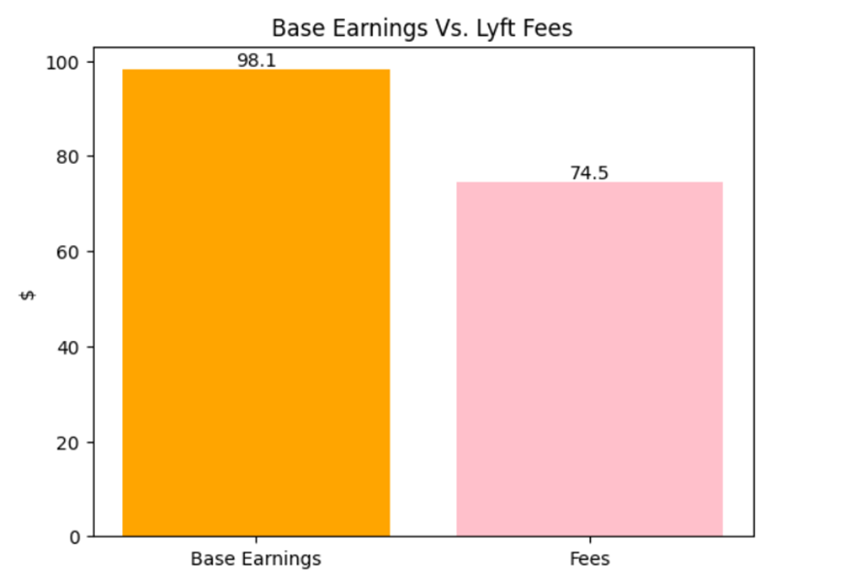
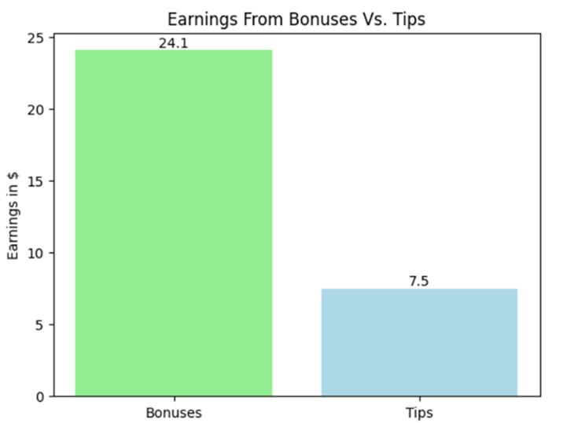
Bar Charts

Slide 14
Dashboard

